Slide 1
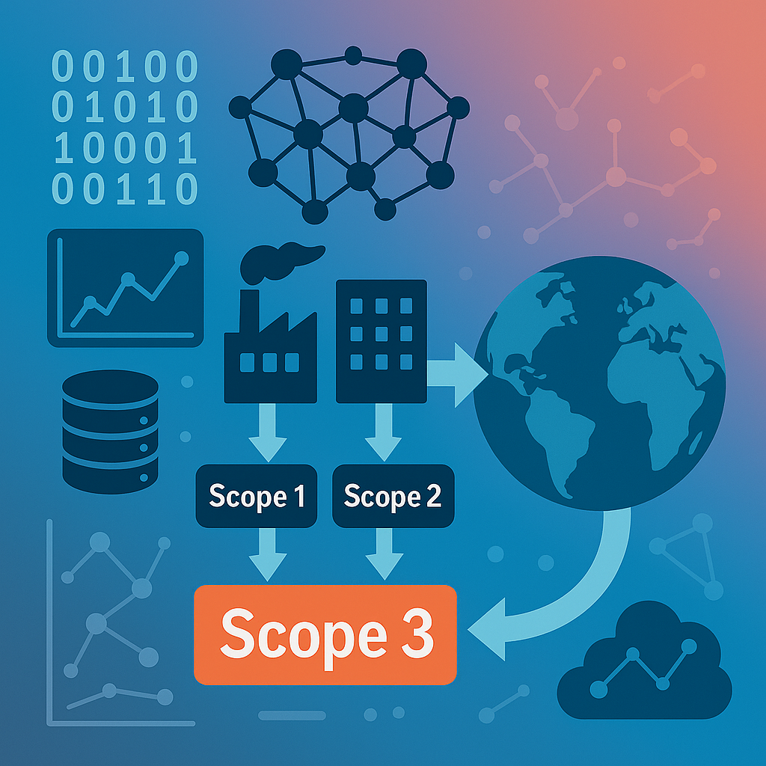
Estimating Scope 3 Emissions at Scale: A Hierarchical Linear Modeling Approach Cliff Hunt MSDS 696 Data Science Practicum II May 1, 2025

Slide 2

Project Overview
Understanding Scope 3 GHG Emissions
Overview of indirect emissions and the importance of estimating them accurately
Data Practicum I Efforts
Initial efforts in data collection, integration, and pipeline design
Addressing Dataset Quality and Consistency
Expanding the Feature Set
Evaluation of financial indicators, Scope 1 & 2 values, and calculation methods
Outlier Detection and Treatment
Z-score filtering, absolute value caps, and winsorization approaches
Exploring Emissions Calculation Methods
Review of reporting variation and its implications for model accuracy
AdaBoost Modeling
Data Preparation
Training and Predictive Output
Hierarchical Linear Modeling Approach
Concept Introduction
Formula & Random Effects Structure
Model Results and Performance
Feature Significance and Reduction
Residual Modeling Insights
Model Evaluation Metrics
Project Wrap-up
Summary of findings, limitations, and future opportunities
Notes:
This presentation walks through the end-to-end workflow of my practicum project focused on estimating Scope 3 GHG emissions at scale.
It begins by grounding the problem and outlining the foundational work done in the Practicum I phase.
From there, we address critical data challenges, expand the feature set, and explore various ways to manage outliers and variations in calculation methods.
We then introduce two modeling approaches—AdaBoost and Hierarchical Linear Modeling—before concluding with a summary of results and key takeaways.

Slide 3
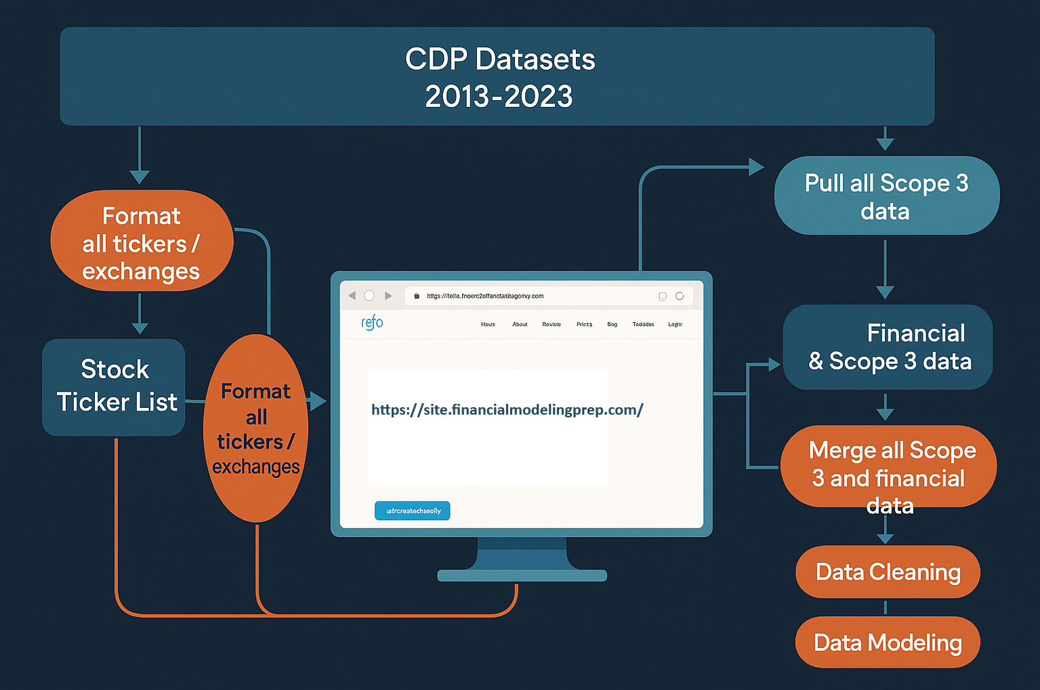
Data Collection using Financial data API
Notes:
Here we briefly recap the workflow for the Data Practicum I efforts. The main task was to integrate CDP Scope 3 emissions data (2013–2023) with corporate financial data collected using an API developed to interface with an online stock info database.
Stock tickers and exchange identifiers were formatted and validated for compatibility with the API.
The system retrieved and merged financial metrics with Scope 3 data to build a unified dataset.
This merged dataset then underwent data cleaning and preparation for downstream modeling and analysis.

Slide 4
Data Cleaning Efforts
Merge all data by year into one dataframe
2013
2014
2015
2013, 2014, 2015, 2016, 2017, 2018, 2019, 2020, 2021, 2022, 2023
Merge all Scope 3 and financial data
2016
2017
2018
2019
2020
2021
2022
2023
Drop unneeded columns, add needed columns
Convert 40+ currencies to USD
Make data types uniform
Fully merged raw data= 914,373 rows x 42 columns
Notes:
Another major component of the Data Practicum I project was the data cleaning process. This involved merging all individual dataframes into a single cohesive dataset.
This process was particularly challenging due to the evolving data formats and schema changes across different years of CDP reporting.
Additionally, financial data from many countries had to be converted to American dollars for accurate comparison.

Slide 5
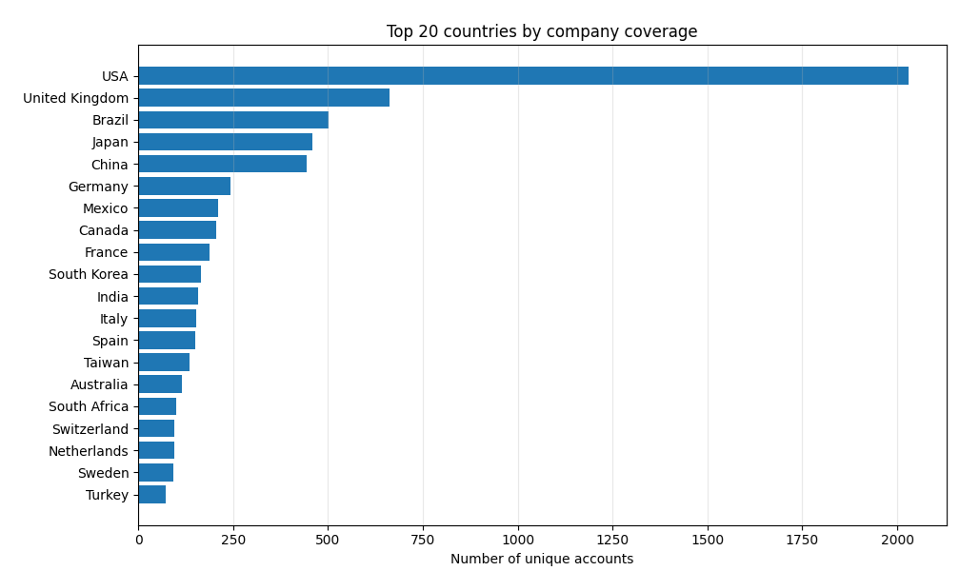
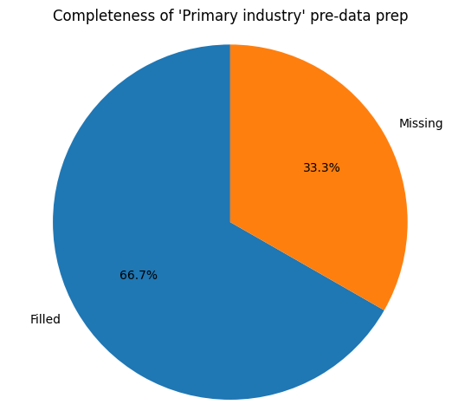
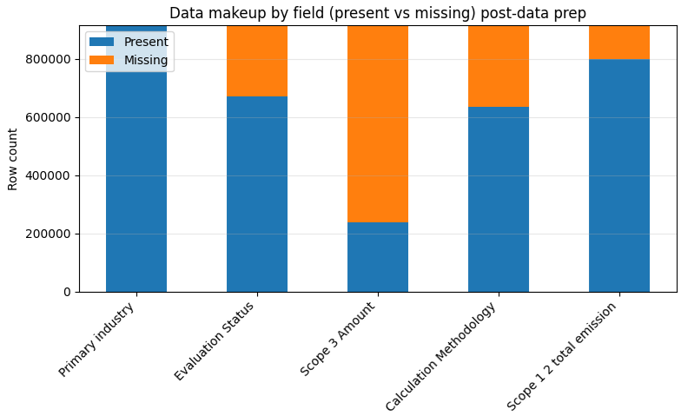
Addressing Missing Industry/Sector Information
Year‑to‑year formatting inconsistencies meant the 2013 – 2017 CDP files lacked company‑level industry, sector, and activity details.
Efforts were made to backfill data using information using later CDP reports, but many gaps remained.
The project therefore focused on rebuilding the data‑preparation pipeline to deliver a cleaner dataset for modeling.
After revising the pipeline, a second backfilling pass was run to capture any additional missing values.
Remaining gaps were filled by creating lookup dictionaries from the ‘GRI’ metadata given in the early CDP submissions.
Code Reference: Final_Data_Prep.ipynb
Notes:
One of the first major efforts of the Data Practicum II project was to complete the backfilling of missing categorical information—specifically industry, sector, and activity classifications—for companies in the CDP dataset.
Earlier CDP reports, especially from 2013 to 2017, often lacked this metadata, which created inconsistencies and modeling challenges across years.
To address this, I focused on finalizing a robust data-preparation pipeline capable of automatically detecting and filling these gaps.
This involved multiple passes of backfilling, dictionary lookups, and the integration of metadata from sources like GRI fields in the earlier CDP datasets.
The result is a much cleaner, more complete dataset—enabling consistent, large-scale modeling of Scope 3 emissions across industries and time.

Slide 6
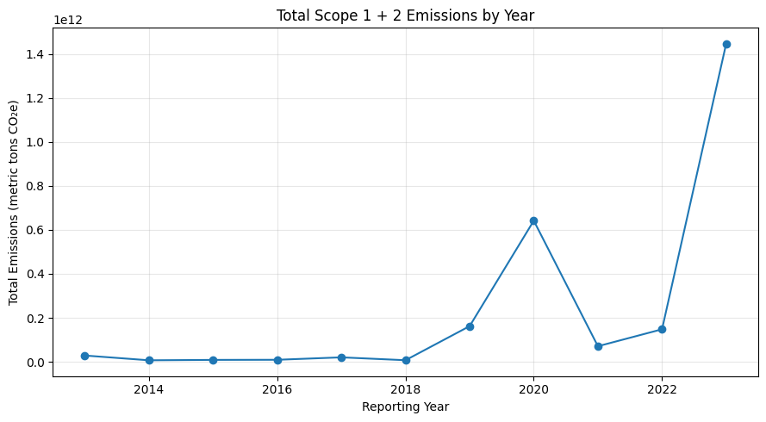
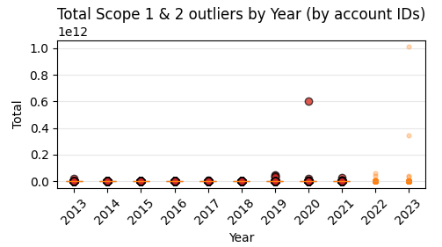
Leveraging Scope 1 & 2 Footprints
Operational‑Intensity Proxy Direct (Scope 1) and energy‑related (Scope 2) emissions scale with the size and energy intensity of operations—strong predictors of upstream and downstream activity that ultimately drives Scope 3.
Readily Audited & Higher Data Quality Companies measure and assure Scope 1 & 2 more rigorously than Scope 3; using them as inputs may be able help the model establish well‑governed, verifiable baselines.
Scope 1 & 2 data (CDP workbooks)
Data Cleaning, Combining, formatting
Store totals by account, year in .json
2013
2014
2015
2016
2017
2018
2019
2020
2021
2022
2023
Coding Approach (Scope1_2.ipynb)
Ingest All CDP Climate‑Change workbook ‑ Reads the Scope 1 (tab C6.1) and Scope 2 (tab C6.3) sheets, standardizes column names, and tags all records with the project years
-Calculates a single Scope 2 amount by summing location‑based and market‑based figures
-Combines Scope 1 and 2 into one total valued due to reporting practice in years 2022, 2023
Notes:
This slide is an outline of some of my efforts into exploring the Scope 1 and 2 data that is also included in the CDP data and as yet has not been utilized thus far in our analysis.
Leveraging Scope 1 and 2 emissions data may be useful in the prediction of Scope 3 values. These emission reports serve as a practical operational-intensity proxy—in that they tend to scale with the size and energy intensity of a company’s activities. Because these activities drive much of the upstream and downstream emissions, Scope 1 and 2 may be indicators of Scope 3 behavior.
Another key advantage is data quality. Scope 1 and 2 figures are generally more rigorously measured, audited, and reported than Scope 3, offering a more reliable and verifiable input to ground our models. This makes them especially valuable for anchoring baseline emissions forecasts.
However, the analysis also reveals an important caveat: even Scope 1 and 2 data can contain extreme outliers, as shown in the visualization. These spikes—particularly in recent years—highlight the need for outlier detection, normalization, or Winsorization before using these features in modeling. While Scope 1 and 2 can improve model accuracy, they must be used thoughtfully to avoid amplifying errors.
Ultimately, incorporating Scope 1 and 2 data provides both predictive power and structural integrity to Scope 3 estimation—so long as the data are appropriately cleaned and scaled.

Slide 7
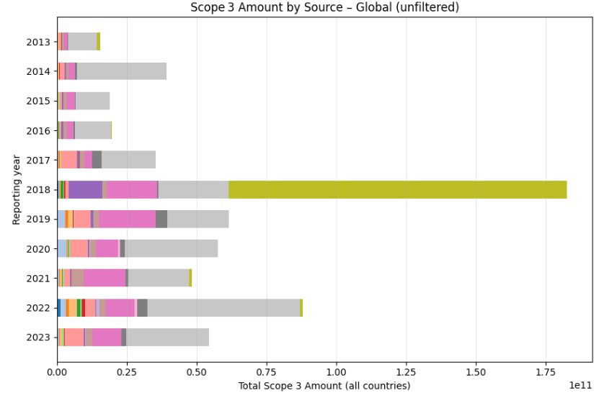
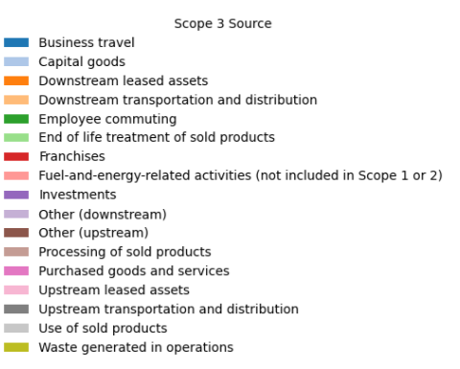
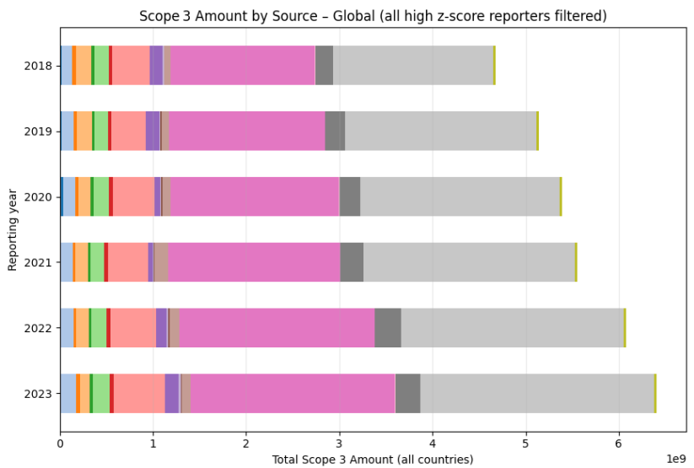
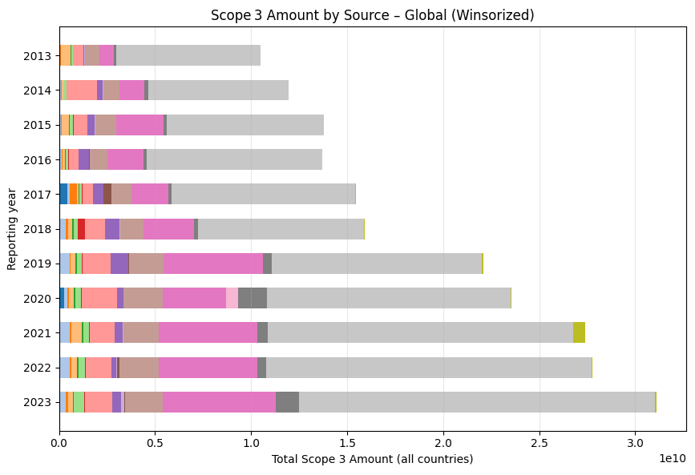
Identifying and Handling Outliers in Scope 3 Emissions Data
Z-score filtering: compute Z-scores on the log-transformed Scope 3 emissions and drop any reporters whose |Z| exceeds a chosen threshold (e.g. 3 – 4), removing extreme statistical outliers.
Absolute‐value filtering: exclude observations above a hard cap (10^9 MT CO₂e) to eliminate unrealistically large emission values that could skew model training.
Winsorization: instead of deleting, cap extreme values at specified percentiles (e.g. top and bottom 1%) so that outliers are pulled in to the nearest threshold—preserving sample size while damping their leverage.
Notes:
When working with Scope 3 emissions data, one of the biggest challenges is identifying and handling extreme outliers — unusually large values that may or may not reflect actual emissions.
These outliers can come from a range of issues: poor estimates, inconsistent reporting methods, unit conversion mistakes, or simply the wide variation between small firms and large multinationals.
If left unaddressed, these values can heavily skew models and lead to misleading results.
The top chart here shows us the unfiltered CDP data. We can notice right away in the 2018 bar that the olive-colored portion representing Waste generated in operations is much larger than any other similar reports in other years and could be a potential outlier.
We tested three main filtering strategies to handle these outliers:
Z-score filtering removes statistically extreme values in log space but may discard rare, valid cases.
Absolute-value filtering places a hard cap, cutting off extreme raw values, which simplifies data but may lose nuance.
Winsorization pulls extreme values back to a defined percentile, preserving more data while softening the influence of outliers.
As you can see in the bottom charts, each of these approaches reshape the data differently.
The key is finding the right balance — reducing the impact of questionable values without removing too much real variation.

Slide 8
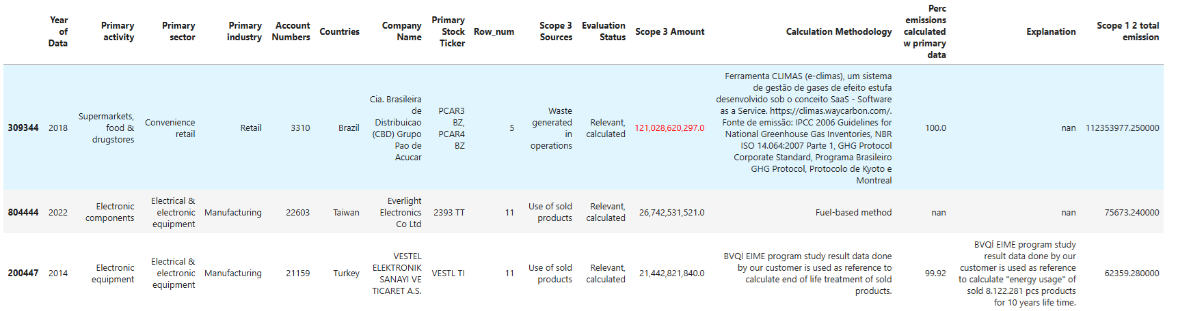
Investigating an Extreme Outlier
Extreme outlier identified: Cia. Brasileira de Distribuição reports 121 × 10⁹ MT CO₂ from waste generated in operations for 2018.
Magnitude beyond norms: that value is over 4 × larger than the next-highest entry in our entire Scope 3 dataset.
Impact on modeling: a single point this large can heavily skew both training and evaluation metrics if left unaddressed.
Calculation methodology caveat: variations in emission factors, system boundaries, or reporting assumptions can produce artificially inflated figures—highlighting the need to standardize methods or adjust for methodological outliers.
Notes:
Continuing from the previous slide we can further investigate the extreme outlier pointed out in the previous slide.
This data point traces back to a Brazilian grocery store chain that reported over 121 billion metric tons of CO₂e in 2018 alone — all from waste generated in operations.
That single value is more than four times larger than the next-highest figure in the entire dataset and far beyond expected industry norms.
A data point of this magnitude, if left unfiltered, can significantly distort model training, inflating errors and skewing predictions.
What’s even more revealing is the calculation methodology used: a software platform described as the CLIMAS Tool, which may rely on custom emission factors or broad assumptions.
This underscores an important challenge in Scope 3 reporting — methodological variation. Depending on the tools, system boundaries, or emission factors used, companies can arrive at drastically different estimates.
Before building the predictive models, I set out to explore whether the calculation methodology may have played a significant role in generating extreme outliers.

Slide 9
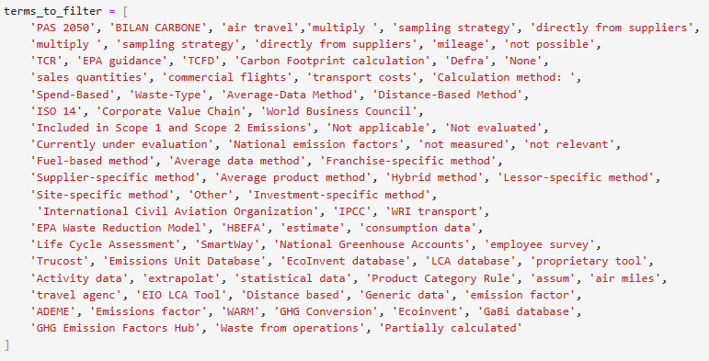
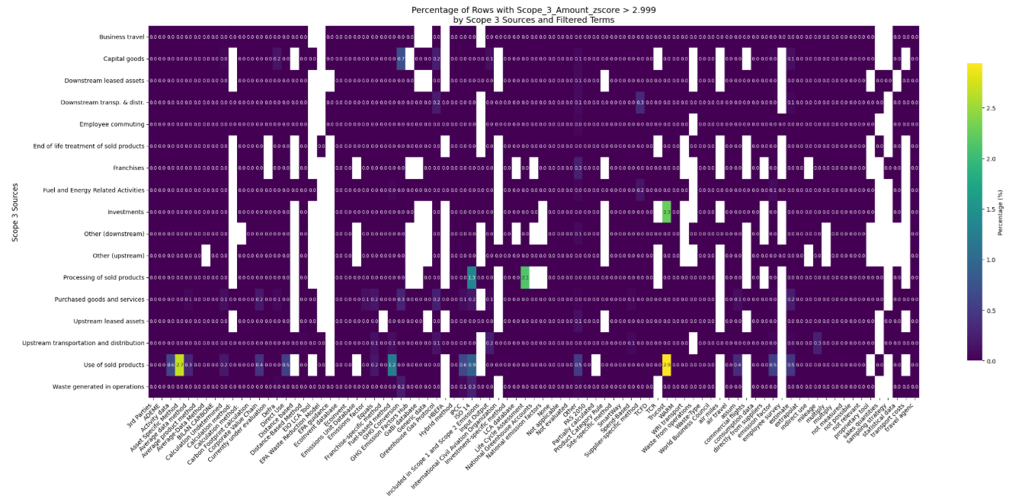
Analyzing Calculation Methods in Scope 3 Reporting
• Diverse Calculation Methods
▸ A total of 78 unique methodologies were identified, ranging from formal protocols to informal descriptions. ▸ Methods used by only one company were excluded to focus on recurring patterns.
• Formal vs Informal Approaches
▸ Formal methods include GHG Protocol, DEFRA, fuel-based, and distance-based techniques—each with unique boundaries and emissions factors. ▸ Informal entries like "Not evaluated" or "Sales quantities" lack consistent structure, making results harder to trust or compare.
• Language and Labeling Challenges
▸ Many methods were written in non-English languages or used ambiguous phrasing, complicating parsing and normalization.
‘Calculation Undetermined’: where no clear methodology could be identified, records were explicitly tagged Calculation Undetermined to flag missing or opaque assumptions.
Modeling value: the chosen calculation method can itself be a powerful feature—reflecting systematic differences in scope definitions, data quality, and reporting practice that drive predictive performance.
TruCost calculation method had the highest prevalence of outliers but is not widely used.
Formal Analysis: Calculation_Methods_Analysis.ipynb
TruCost
Notes:
This slide highlights the complexity and inconsistency in how companies report Scope 3 emissions.
Across the dataset, 78 unique calculation methods were uncovered, ranging from formal frameworks like the GHG Protocol or DEFRA, to vague or non-standard labels like 'Not evaluated' or 'Sales quantities’.
Many of these informal entries lack clear boundaries or formulas, which makes it difficult to compare emissions across companies or sectors reliably.
Language barriers also posed a challenge as many method descriptions were in their native languages, further complicating automated parsing and normalization.
The heatmap below shows the prevalence of high z-score amounts by scope 3 type and calculation method on the x axis.
To help flag uncertainty, records with unclear or unrecognized methods were labeled as 'Calculation Undetermined', which you can see reflected in the heatmap.
Interestingly, certain methods—such as TruCost—were linked with a higher prevalence of statistical outliers, raising concerns about how underlying assumptions may influence reported totals.
More data points would be needed, however, to draw definitive conclusions on the accuracy of any specific methods.
Overall, this analysis reinforces the idea that the choice of calculation method isn’t just a technical detail—it can shape the emissions figure itself, and by extension, affect the reliability of predictive models.

Slide 10
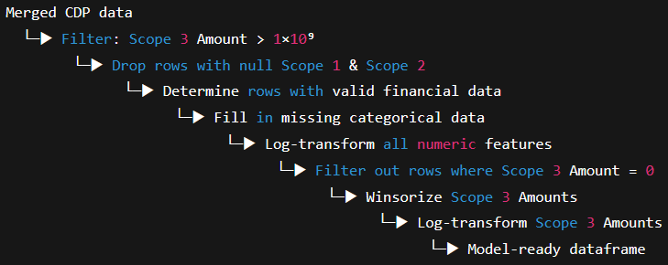
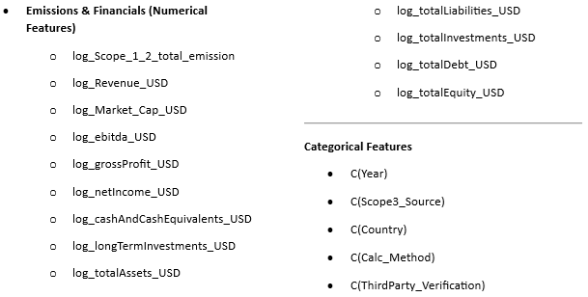
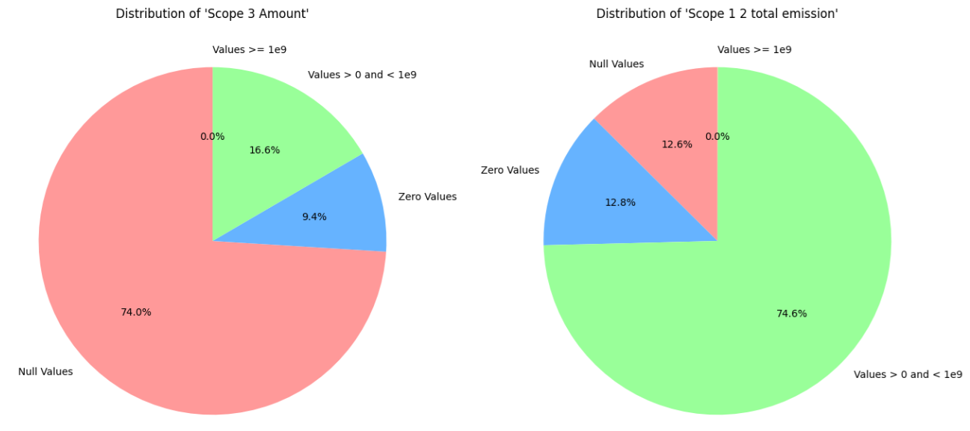
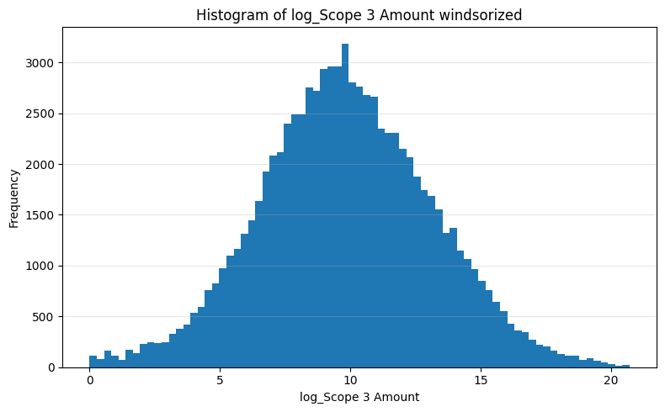
Final Data Prep
Scope filtering & Null exclusions: Kept only companies reporting non-zero Scope 3 emissions below 1×10⁹ MT CO₂ and any rows missing both Scope 1 and Scope 2 values, and those lacking core financial metrics.
Log transformations: Applied signed log to all numeric features, including revenues, assets, and total emissions, to reduce skew.
Target winsorization: Capped the highest 1 % of Scope 3 values before re-applying a log transform to stabilize the distribution.
Final output: Produced a model-ready Dataframe with ~14 log-scaled financial/emissions features and 5 encoded categorical variables.
Code Reference: Final_Data_Prep.ipynb
Possible features
Target Scope 3 values
Notes:
Here we outline the final steps taken to prepare the various datasets used for modeling.
We begin by merging CDP-reported emissions data across Scopes 1, 2, and 3 with corresponding financial information, creating a unified dataframe.
From there, the dataset is filtered to include only companies that reported non-zero Scope 3 emissions less than 1 billion metric tons of CO₂e and excluded any rows missing both Scope 1 and 2 values or key financial variables.
Categorical fields like country, year, Scope 3 source, and verification status were imputed where possible using available metadata.
To reduce skew and stabilize variance, all numeric fields—including emissions and financials—underwent a signed log transformation.
We also applied winsorization, capping the top 1% of Scope 3 values before re-transforming, ensuring that extreme outliers didn’t distort the model training.
The result was a clean, model-ready dataset with approximately 14 log-scaled numeric features and 5 encoded categorical variables.

Slide 11
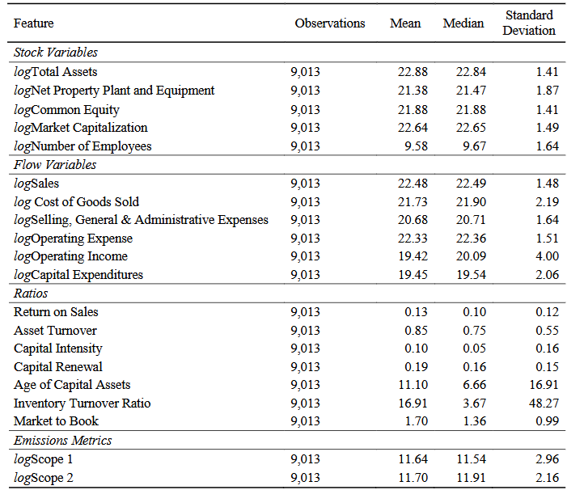
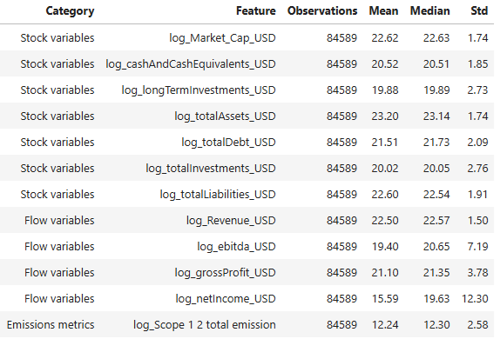
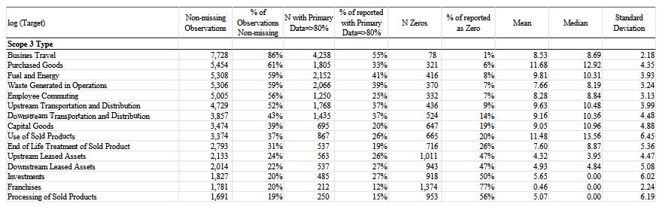
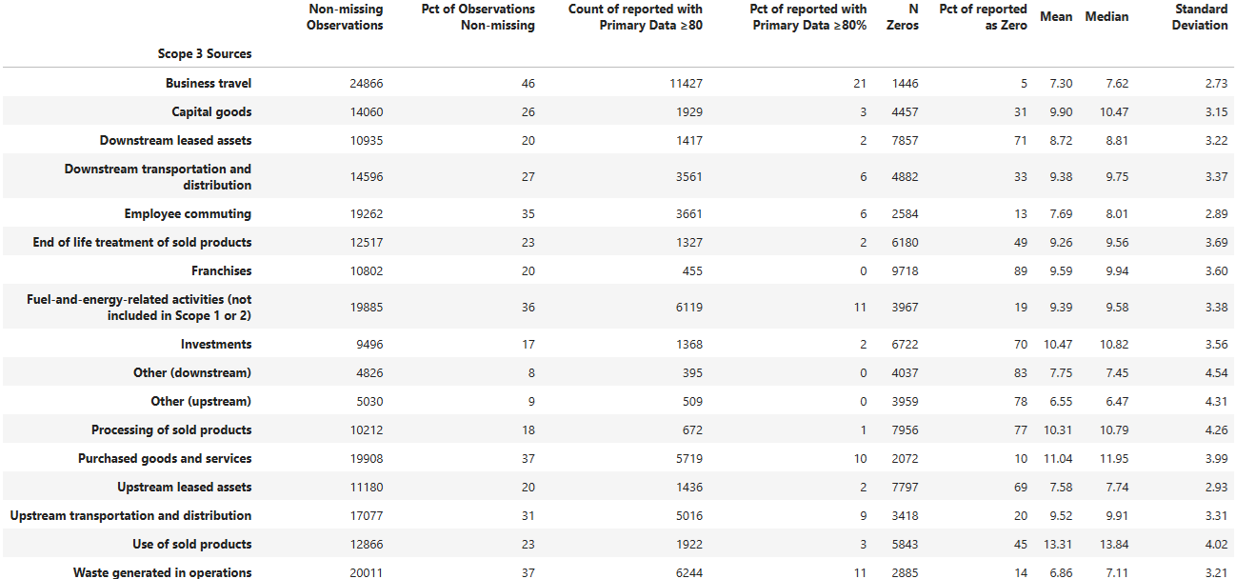
Pre-Modeling Data Inspection
CDP 2013–23; Scope 1 & 2 / financial variables / no zeros / winsorized
After data preparation, we can directly compare sample sizes and distributional characteristics to the previously published analysis.
That analysis was also a CDP-derived GHG emissions dataset that contained just over 9,000 records, versus roughly 84,000 observations in our current set.
Although several financial metrics overlap between the two datasets, each includes unique variables as well so not the same feature set.
The previous CDP-based approach also incorporated Scope 1 and Scope 2 emissions as predictors and applies log transformations to all features and the target.
Serafeim & Caicedo dataset
Notes:
One of the goals of the initial modeling effort was to follow a similar approach to that of the Serafeim and Caicedo analysis which was a similar modeling effort previously published in 2022.
Their approach also combined financial data with emissions reporting to model Scope 3 emissions using the AdaBoost algorithm.
One of my key objectives was to evaluate whether applying a comparable dataset and modeling technique could yield results consistent with those reported in their study.
This slide compares the feature sets and summary statistics between the two datasets. While there is some overlap in the financial metrics used—such as market capitalization, revenue, and assets—each dataset also includes unique variables, so the feature sets are similar but not identical.
Both studies rely on CDP-reported emissions data, but our dataset draws from a broader time range, resulting in significantly more observations—roughly 84,000 in our case compared to just over 9,000 in the original analysis.
This increase in volume, along with updated and expanded financial features, allows for a more robust modeling framework while still maintaining continuity with the earlier methodology.

Slide 12

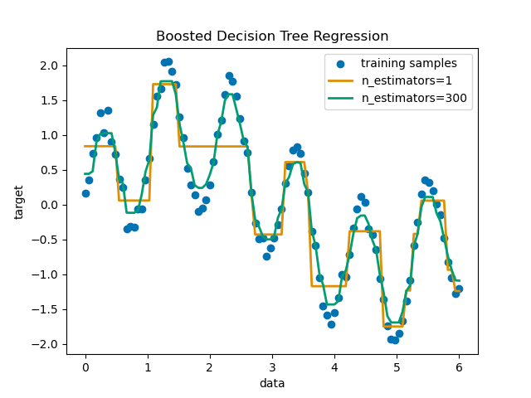
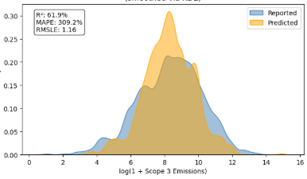
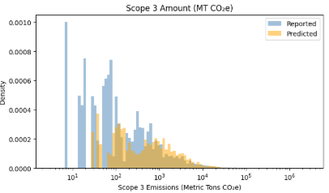
Adaboost Modeling & Workflow
End-to-End Pipeline:
AdaBoost (from the sklearn.ensemble library) sequentially fits shallow trees to correct prior errors and combines them via weighted voting.
Pros:
Captures complex non-linearities by re-weighting errors each round
Provides built-in feature importance scores for interpretability
Robust to overfitting relative to a single tree
Cons:
Sensitive to outliers (early rounds overweight extreme errors)
Must tune depth & number of learners to balance bias/variance
Preprocessed master DataFrame
Split into 17 Sub-DataFrames
(one per Scope 3 source)
For each subset, run:
AdaBoost Pipeline:
-Preprocess features
-Fit n estimators trees
-Produce y=log(emissions)
Collect log-scale predictions
Back-transform to
Emissions MT = exp(y) -1
Final outputs in
MT CO2e
Notes:
This slide outlines how I initially used AdaBoost to model Scope 3 emissions across 17 different source categories as did the previously published effort.
AdaBoost is an ensemble technique that builds a series of shallow decision trees. Each new tree focuses on correcting the mistakes of the ones before it, and the final prediction is made by combining these models through weighted voting.
There are a few key strengths that make AdaBoost attractive for our application:
It can capture complex non-linear relationships by iteratively reweighting errors,
And it tends to be more robust to overfitting than a single decision tree.
However, it’s also sensitive to outliers—especially in the early rounds—and it requires careful tuning of both tree depth and the number of estimators to avoid overfitting or underfitting.
On the right, we show the end-to-end modeling pipeline. We start with a fully preprocessed dataset and split it into 17 smaller subsets—one for each Scope 3 source. For each subset, we run a dedicated AdaBoost pipeline that preprocesses features, fits a sequence of trees, and outputs log-transformed emission predictions.
These predictions are then back-transformed into actual emission units—Metric Tons of CO₂e—so we can compare them directly to the reported values. The result is a flexible, source-specific modeling framework that scales across the full emissions dataset.

Slide 13
Adaboost Modeling Output
High Z-Score Reporters Filtered Data
Winsorized non-zero Data
Notes:
Here, we can walk through the inputs and outputs of the AdaBoost algorithm using two distinct datasets.
On the left, we use a dataset where high Z-score reporters have been aggressively filtered out to remove extreme outliers and does not contain Scope 1 and 2 data.
On the right, the dataset has been winsorized to cap extreme values and filtered to exclude zero-emission reports, it also contains the corresponding Scope 1 and 2 data as additional features.

Slide 14
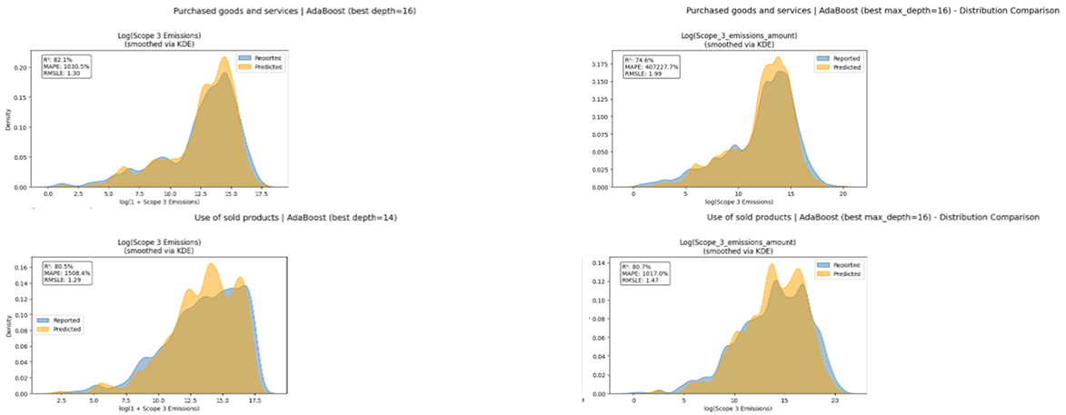
Adaboost Modeling Output
High Z-Score Reporters Filtered Data
Winsorized non-zero Data
Notes:
Here we see several of the AdaBoost modeling outputs generated from both datasets.
The results are presented on the log scale, comparing the reported emissions against the model’s predicted values.

Slide 15
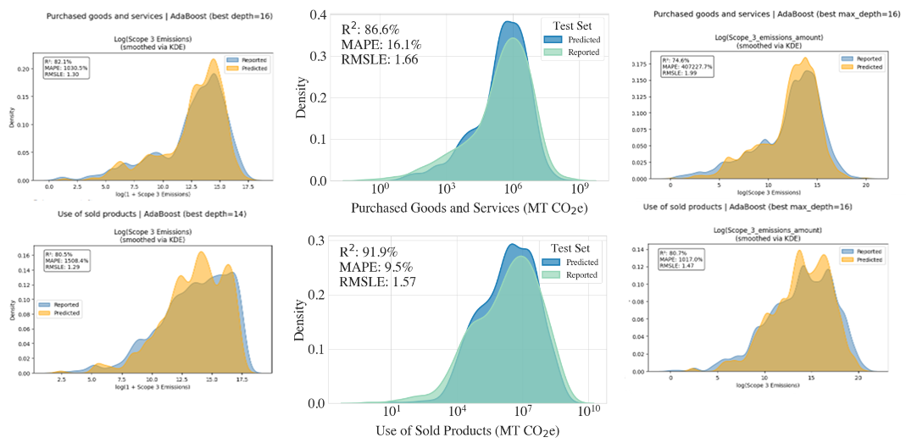
Adaboost Modeling Output
High Z-Score Reporters Filtered Data
Winsorized non-zero Data
Serafeim and Vélez Caicedo (2022)
Notes:
The added center plots present the published results from the Serafeim and Vélez Caicedo (2022) study, serving as a benchmark for comparison.
The R² metric shown represents the proportion of variance in reported emissions that the model is able to explain—specifically on a log-transformed scale. Higher R² values indicate better model performance, where predicted values closely track actual emissions.
As reflected in the visual alignment of the distributions, the benchmark model achieves strong predictive accuracy, reinforcing the utility of log-scale modeling for Scope 3 emission estimation.

Slide 16
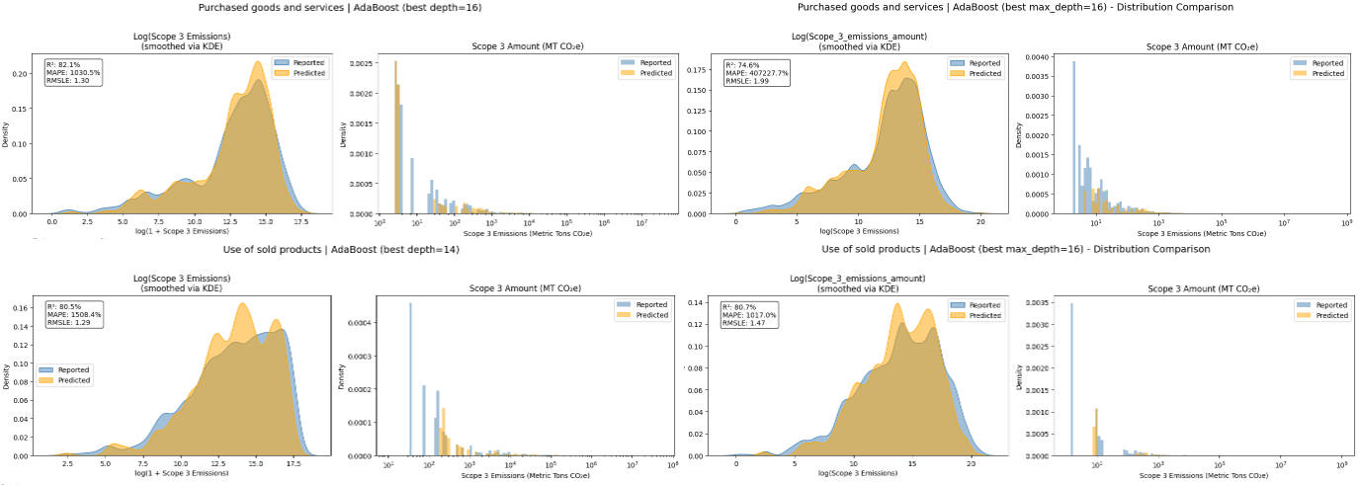
Adaboost Modeling Output
High Z-Score Reporters Filtered Data
Winsorized non-zero Data
Notes:
The final step—absent in the previously published study—involves converting the model’s log-scale predictions back to actual metric tons of CO₂ and comparing them directly with reported values.
This real-scale comparison reveals a noticeable mismatch between predicted and reported emissions, particularly in cases where Scope 3 values are very small.
This discrepancy is captured by the MAPE (Mean Absolute Percentage Error) metric, which quantifies the average percentage deviation of predictions from actual values.
Elevated MAPE values in these scenarios are often driven by near-zero emission reports, where even small absolute errors produce disproportionately large percentage errors—highlighting a known limitation of using MAPE in such contexts.
In essence, this step answers: “On average, how far off are we, relative to the true emissions?” and underscores the importance of interpreting performance metrics with care when dealing with skewed or low-magnitude data.

Slide 17
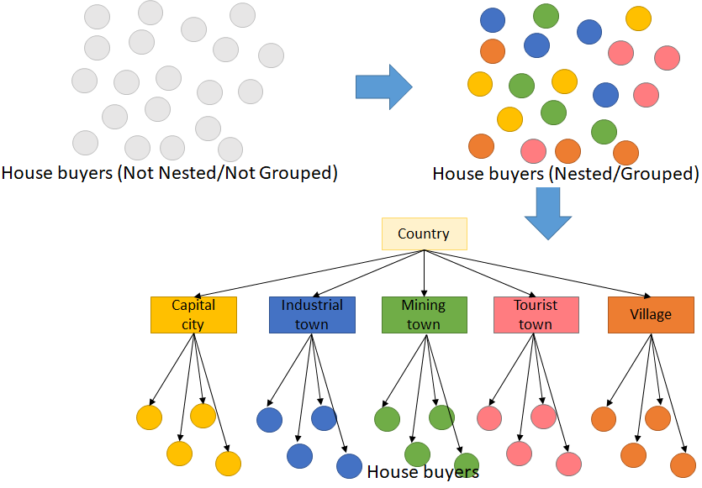
Hierarchical Linear Modeling: Leveraging Nested Data
HLM allows us to leverage the nested structure of emissions data—years within companies, companies within industries—to produce more robust, context-aware estimates.
Nested data structure: explicitly models emissions observations (Level 1) clustered by company (Level 2) and industry (Level 3), capturing both within- and between-group variation.
Random intercepts & slopes: allows each industry and each company to have its own baseline emissions and trend over time, rather than forcing a single global effect.
Partial pooling: “borrows strength” across companies and industries, stabilizing estimates where data are sparse—ideal for smaller reporters or short time series.
Improved prediction & inference: by accounting for hierarchy and temporal dynamics simultaneously, HLM can yield more accurate emissions forecasts and clearer insights into cross-industry differences.
Notes:
Another Machine Learning technique that we might use to model Scope 3 emissions is Hierarchical Linear Modeling.
HLM is a powerful statistical approach designed to handle nested data structures—where observations are grouped within higher-order categories. In the context of greenhouse gas (GHG) emissions, this means leveraging the natural hierarchy of data such as emission values reported each year would be Level 1, nested within companies would be Level 2, which are themselves are part of broader industries or sectors which would be Level 3.
Rather than forcing a one-size-fits-all model, HLM allows us to capture meaningful variation within and across these groups.
A key advantage of HLM is the use of random intercepts and slopes, which enables each company and industry to have its own baseline emissions level and trend over time—offering flexibility that better reflects real-world differences. Additionally, partial pooling “borrows strength” across groups, which helps stabilize estimates when data is limited—such as for smaller firms or short time series—while still preserving group-level distinctions.
The visual on the right uses a simple analogy to explain this concept: instead of analyzing individual house buyers without context (left), we could group them by city or town (right), accounting for shared traits within each community. Just as buyers in different towns may behave differently, companies in various industries may exhibit distinct emission patterns. HLM respects and models this structure, enabling more accurate predictions and richer insight into cross-industry GHG dynamics.

Slide 18
Hierarchical Linear Modeling (HLM) for Scope 3 Emissions
Level 3 (Industry: Retail): fits a shared baseline intercept and growth rate for the entire retail sector—e.g. all Retail companies start from a common emissions “anchor” and trend.
Level 2 (Company: Walmart, Target, Costco): allows each retailer to deviate from that industry curve with its own intercept and slope—capturing firm-specific efficiencies or expansion.
Level 1 (Yearly observations): models each annual log-Scope 3 emission report (e.g. Walmart 2018, Walmart 2019, …) around its company’s trajectory, with residual error.
Partial pooling across levels: small chains with few years borrow strength from the sector and larger peers, preventing over- or under-reaction to one anomalous data point.
Retail
Target
Walmart
Amazon
Costco
2018
2020
2018
2020
2018
2020
2018
2020
2019
2021
2019
2021
2019
2021
2019
2021
Notes:
Building on the concept of nested data introduced in the previous slide, here we show how Hierarchical Linear Modeling (HLM) could be applied to Scope 3 emissions in the retail Industry. The visual breaks down the t
Level 3 (Industry – Retail): At the top of the hierarchy, all retailers share a common emissions baseline and growth trend. This industry-level model defines a general “anchor” for expected emissions behavior, serving as a reference for all companies within the sector.
Level 2 (Company – Walmart, Target, Amazon, Costco): Each company is allowed to deviate from the industry trajectory with its own intercept and slope, reflecting firm-specific operational strategies, supply chain structures, or sustainability initiatives. This flexibility captures real-world differences in how companies behave—even within the same industry.
Level 1 (Yearly Observations): Each year’s Scope 3 emissions report (e.g., Walmart 2018, Amazon 2020) is modeled as a data point influenced by its company-level trend and residual noise. This allows the model to account for natural fluctuations and reporting inconsistencies while maintaining structure.
Lastly, smaller or less-reported companies benefit from borrowing strength from the broader industry and their peers. Rather than relying solely on their limited data, their estimates are “guided” by sector-wide trends—preventing overreaction to outliers and improving stability when data is sparse or noisy.
In sum, this approach allows us to model emissions more realistically—recognizing that companies operate within industries, and emissions evolve over time. By layering these influences, HLM delivers more accurate forecasts and better generalizability across the emissions landscape.

Slide 19
HLM formula
Building the Mixed-Effects Recipe Using the statsmodels Library
Target (response): log_Scope_3_Amount
Log-transform all financial drivers:
Linearizes multiplicative relationships
Tames extremes so one mega-cap firm can’t dominate the fit
Cover the whole balance sheet: Cash flow (EBITDA), profitability (gross/net income), assets, liabilities, and debt provide complementary signals about a company’s operating footprint.
Add hierarchical structure with categorical terms:
C(Year) – Absorbs any global shift in reporting practices or macroeconomic conditions
C(Country) – Captures national effects (e.g., grid mix, regulations) without requiring dozens of dummy variables
response ~ fixed-effect predictors + categorical dummies
formula = (log_Scope_3_Amount ~ log_Revenue_USD + log_Market_Cap_USD + log_ebitda_USD + log_grossProfit_USD + log_netIncome_USD + log_cashAndCashEquivalents_USD + log_longTermInvestments_USD + log_totalAssets_USD + log_totalLiabilities_USD + log_totalInvestments_USD + log_totalDebt_USD + log_totalEquity_USD + C(Year) +C(Country))
Notes:
Now that we've introduced the concept of Hierarchical Linear Modeling, this slide walks through how we structure the actual model formula using Python’s statsmodels library. We refer to this as building the mixed-effects recipe, where we combine the right response variable, appropriate financial predictors, and categorical group structures that define our model hierarchy.
We begin by defining our target variable— 🔹 log_Scope_3_Amount, the natural log of reported Scope 3 emissions.
Next, we cover the full balance sheet with our fixed-effect predictors: We include log-transformed financial variables that reflect multiple dimensions of a company's operational footprint:
Together, these provide a well-rounded view of corporate scale, investment patterns, and financial health—each a potential driver of Scope 3 emissions.
To layer in the hierarchical structure, we introduce categorical terms:
C(Year) helps absorb any global shifts that affect all companies equally—such as policy changes or macroeconomic disruptions.
C(Country) accounts for national context like grid emissions intensity or regulatory frameworks, without requiring a separate dummy for every country.
All of this comes together in our general model structure highlighted in blue:
And in its fully refined code form, our formula looks like the yellow highlighted portion:
This formula allows us to balance global economic context with firm-level financial indicators while capturing variation across years and countries. It serves as the backbone for our mixed-effects model, anchoring our predictions in both financial structure and real-world emissions behavior.

Slide 20
HLM random-effects structure
Random-effects structure
model = smf.mixedlm(formula, df, groups = df["Primary_sector"], vc_formula = {"Company": "0 + C(Company)" })
groups=df["Primary_sector"]
Specifies a random intercept for each industry sector (e.g. Retail, Manufacturing, Energy).
Intercepts b_{0,sector}​ capture how entire sectors sit above or below the overall mean log-emissions.
vc_formula={"Company": "0 + C(Company)"}
Adds a second variance component: a random intercept for each company nested (or cross‐classified) within its sector.
Intercepts b_{0,company} let each firm deviate further from its sector’s baseline—capturing firm‐specific reporting practices or efficiency.
Causes for non-convergence:
Sparse group data: Too few observations per group leads to unreliable variance estimates.
Overlapping group terms: Redundant or nested structures create collinearity and parameter confusion.
Too many variance components: Excessive random effects overcomplicate the model and hinder convergence.
Notes:
Once we have defined the formula then we can incorporate it into the random effects structure.
This refers to the part of a statistical model that accounts for group-level variability in the data that is not explained by fixed predictors.
The Fixed effects are Coefficients that are constant across all observations such as the effect of revenue or assets on emissions.
The Random effects are Group-specific deviations from the fixed-effect baseline—used to model variability within and between groups like companies, sectors, or countries.
Suppose you're modeling corporate emissions:
The fixed effects might say: “Every $1B in revenue increases emissions by X metric tons.”
But each company might behave differently due to efficiency, supply chains, etc.
So, you model a random intercept for each company, allowing the baseline emissions level to shift up or down.
You can also model random slopes—allowing the effect of revenue, for instance, to vary by company or sector.
To capture this layered variation, we define the random effects structure using two components: groups and vc_formula.
We begin with:
groups = df["Primary_sector"] This sets a random intercept for each industry sector, such as Retail, Manufacturing, or Energy. These sector-level intercepts account for broad structural differences—showing whether a given sector tends to report higher or lower emissions than the global average, all else being equal.
Next, we refine the model with:
vc_formula = {"Company": "0 + C(Company)"} This adds a second layer of variation, introducing random intercepts for each individual company, nested (or potentially cross-classified) within its sector. These firm-specific intercepts allow companies to deviate further from their sector’s baseline, capturing nuances such as internal efficiency, data quality, or unique reporting practices.
I was surprised while developing the model to find that it would fail to converge when the formula became overly complex. To ensure successful convergence across all 17 models, I initially had a very complex model with many categorical variables. After failing to converge, though, I had to start with a much simpler model and slowly add terms thus I wasn’t able to include all the variables I had planned on in the beginning.

Slide 21
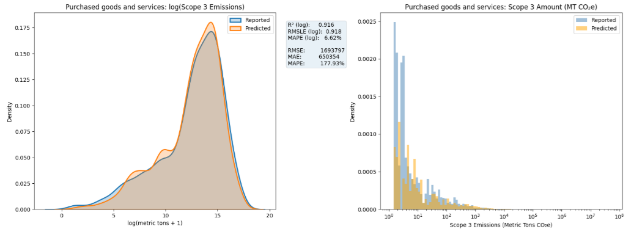
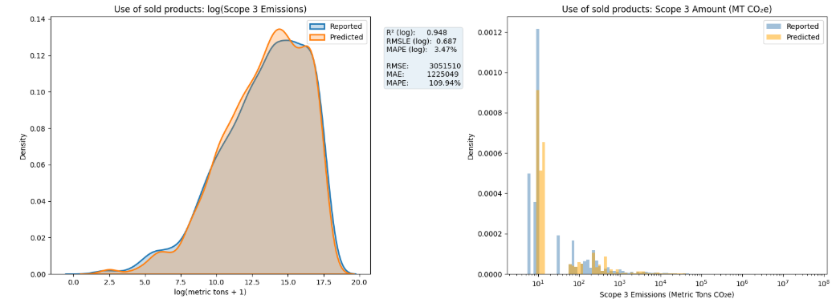
HLM Modeling Outputs
Dataset segmentation: The Scope 3 dataset was divided into 17 distinct categories of emissions sources, each modeled separately to better capture industry- and activity-specific patterns. ▸ Examples of categories include "Purchased Goods and Services" and "Use of Sold Products."
Log-transformed modeling: ▸ Both the reported and predicted Scope 3 emissions are log-transformed to:
Density plots (left side): ▸ Show how well the model captures the distribution of log-transformed reported vs. predicted emissions. ▸ Strong overlap between curves suggests effective model fit.
Reverse-transformed results (right side): ▸ Depicts Scope 3 emissions in their original units: Metric Tons CO₂e. ▸ Axes use logarithmic scales to accommodate the wide range of emission magnitudes. ▸ These visuals illustrate real-world interpretation of model predictions compared to actual reported values.
Notes:
This slide presents modeling results for two of the 17 Scope 3 source categories—Purchased Goods and Services and Use of Sold Products—which were each modeled separately using the HLM formula and random effects structure.
Segmenting the dataset into 17 separate models allows us to better reflect the unique emissions behavior associated with different business activities but also cuts down on the number of observations for each group.
Both the reported and predicted emissions values were log-transformed prior to modeling. This stabilizes variance, reduces skew, and helps the model better capture proportional relationships.
On the left side, the density plots compare the distribution of predicted and reported values on the log scale. We see strong overlap between the two curves, particularly for Use of Sold Products, which suggests a good model fit. This is supported by relatively high R² values—0.92 and 0.95, respectively.
However, on the right side, when we reverse-transform the predictions back to their original units—Metric Tons of CO₂e—we start to see a more nuanced picture.
The log scale helps model the overall pattern, but in absolute terms, we still observe meaningful differences between predicted and reported values.
This is reflected in the MAPE values, which exceed 100% for both categories—indicating that while the shape of the distribution is well captured, the model tends to under- or over-estimate emissions substantially in magnitude.
In short, the model is effective at learning relative structure, but the absolute accuracy—especially for high-emitting firms—remains a challenge.

Slide 22
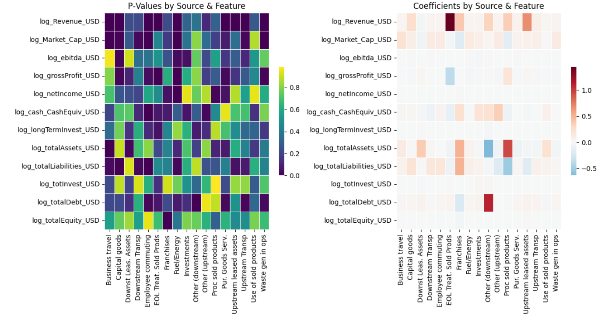
Streamlining HLM Models through Feature Reduction
Feature reduction streamlines the model by identifying and removing the least influential financial features while retaining predictive accuracy making the model simpler and less resource intensive.
Each variable in each model has a coefficient intensity to gauge practical influence and a p-value to evaluate statistical significance.
In the left-hand visualization, darker cells in the heatmap signify lower P-values and higher significance. In the right-hand visualization, darker cells indicate higher coefficients and thus more influence.
Revenue and Market Cap are consistently significant across most Scope 3 types while EBITDA, Net Income, Long Term Investments, Total Investments, and Total Equity show minimal contributions.
Notes:
Now that we’ve built our hierarchical models across all 17 Scope 3 source types, the next step is to see if feature reduction is possible — simplifying the model without sacrificing predictive performance.
On this slide, we’ve visualized the results of that process.
On the left, we have a heatmap of p-values for each financial feature across all Scope 3 categories.
Darker colors indicate statistical significance — so we’re looking for features that consistently appear as dark cells across multiple sources.
On the right, we have a corresponding heatmap of the standardized coefficients — this tells us not just whether a feature matters statistically, but also how much practical influence it has on the model’s predictions, and in what direction.
What we see from the heat maps is that Revenue and Market Capitalization stand out as significant features. They are statistically significant in many of the categories, and they show strong coefficients. These two variables provide broad, reliable signals across industry contexts.
On the other hand, some features consistently showed low statistical significance and low coefficient of intensity.
By removing these less impactful variables and rerunning a pared down version of the model, we’re able to streamline the model, reduce redundancy, and improve generalization.
This step is especially important when applying the model to incomplete or noisy real-world data, where fewer, more powerful predictors make the model more robust and easier to deploy.

Slide 23
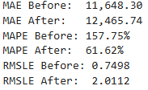
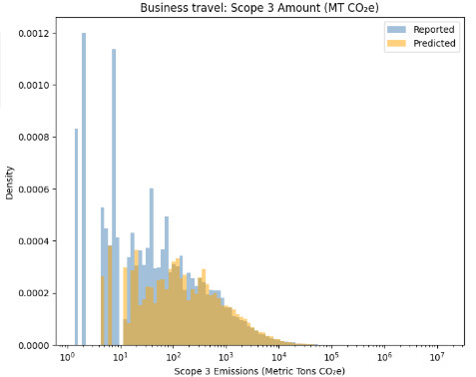
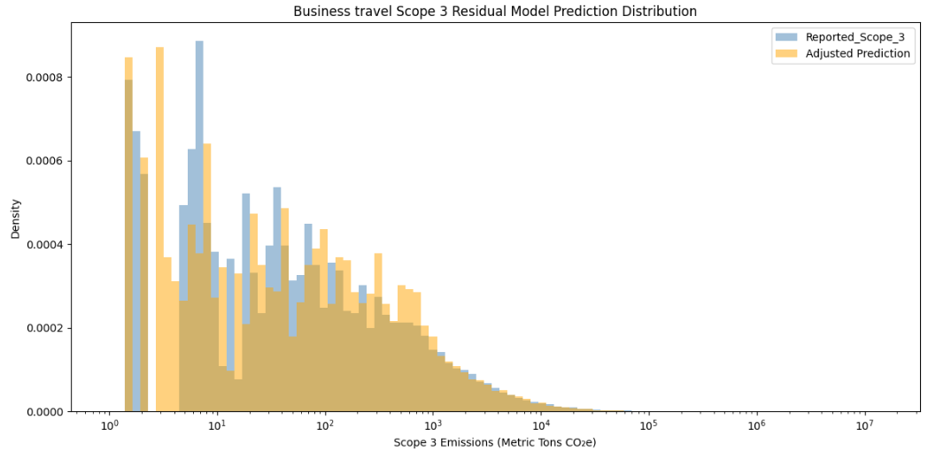
HLM improvement with Residual Modeling
Residual modeling is a two-stage approach where first a primary model is fit and then a secondary model learns on the primary model’s errors (residuals).
Utilized RandomForestRegressor from the sklearn.ensemble library
By training the residual model on the hardest-to-predict cases, one can capture patterns the first model missed—often improving accuracy on under-represented or extreme observations.
Lastly, combine the original predictions with the residual‐corrections to yield an “adjusted” forecast that reduces systematic bias and lowers overall error.
Residual Modeling
Notes:
As we have seen previously, HLM can provide high R squared values in the logged output but give poor results in real metric tons with metrics such as MAPE.
One way that we might improve these results is through residual modeling.
Residual modeling offers a powerful two-step strategy for refining predictions. First, we train a primary model to capture the broad structure in the data. But instead of stopping there, we take it a step further—fitting a secondary model specifically on the residuals, or errors, left behind by the first.
This second model focuses on the most difficult cases—the outliers, edge conditions, and under-represented observations where the original model struggled. By doing so, it helps uncover patterns that were missed in the first pass.
Finally, we blend the original predictions with the residual model’s corrections. The result is a more balanced, adjusted forecast that reduces bias, improves accuracy, and better handles the extremes.

Slide 24
Datasets/Modeling Combinations Explored
Below is an overview of dataset variants and modeling approaches used in this study. These labels will be referenced in the results on the following slides.
Label | Description
AdaBoost_Winsor | CDP 2013–23; Scope 1 & 2; financial variables; no zeros; winsorized; AdaBoost
AdaBoost_GHG | CDP 2013–23; financial variables; no zeros; Z-score outliers removed; AdaBoost
HLM_full | CDP 2013–23; financials; no zeros; Z-score outliers removed; HLM (Sector/Company)
HLM_reduced_resid | CDP 2013–23; financials; no zeros; Z-score outliers removed; HLM feature reduced with residual modeling
SC_AdaBoost | Serafeim & Caicedo dataset (CDP 2013–20); Scope 1 & 2; no zeros; winsorized; AdaBoost
Notes:
Before diving into the results, this slide introduces the five key dataset and model combinations that I’ll reference throughout the remainder of the presentation.
Each label represents a specific combination of preprocessing choices—such as whether Scope 1 and 2 emissions were included, if outliers were winsorized or removed by Z-score, and which modeling algorithm was used, either AdaBoost or hierarchical linear modeling.
For example, AdaBoost_Winsor uses financial data along with Scope 1 and 2 emissions, removes zeros, and applies winsorization to extreme values. HLM_reduced_resid, on the other hand, uses a hierarchical linear model with residual modeling and omits Scope 1 and 2 predictors.
Lastly, SC_AdaBoost reflects the approach used by Serafeim and Caicedo, providing a point of comparison to prior published work.
These labels will appear throughout the upcoming performance and feature analysis slides, so this serves as a reference for interpreting the results.

Slide 25
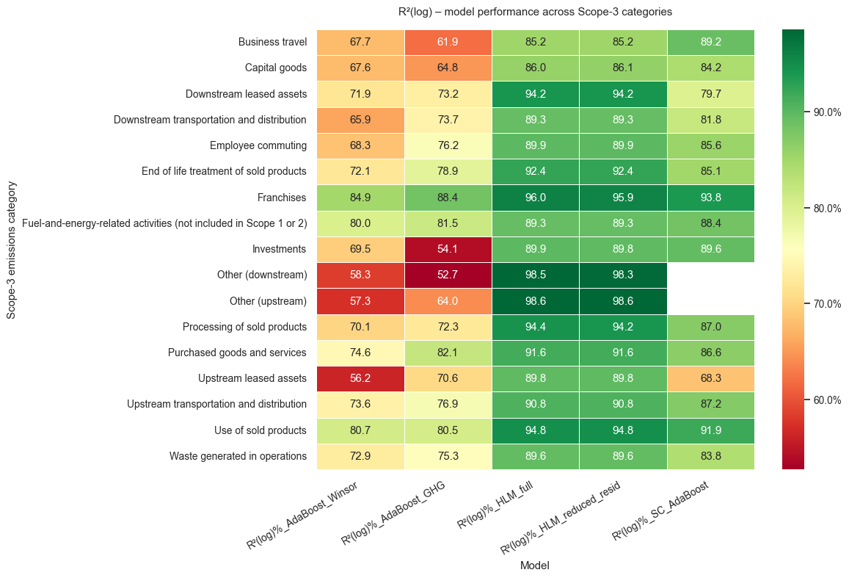
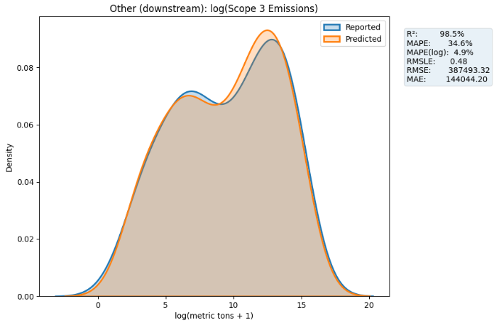
Comparing Predictive Accuracy Using Log-Scaled R² Values
What does R² tell us?
Captures “how much” of the story we explain. R² compares your model with a dummy model that just predicts the average emission.
• 100 % → perfect: every predicted point sits on the 45 ° line.
• 0 % → no gain over the average-emission guess.
• < 0 % → model is worse than the dummy (rare, but possible).
Think of R² as a relative score, not an error size It shows the share of variation explained but says nothing about how many tons you miss by. That’s why it needs to be paired with error metrics (MAPE, RMSLE, RMSE) (Rocca, 2024).
Notes:
First lets take a look at the R-squared metric in the log scale. At its core, R² captures how much of the variation in emissions our model explains. It compares our model to a basic 'dummy' model — one that always predicts the average value. So, we can think of R² as a score from 0 to 100 percent:
If R² is 100%, our model perfectly predicts every point.
If it’s 0%, then our model is no better than guessing the average.
It tells us how much variation we explain, but not how far off our predictions are in absolute terms — like how many tons of CO₂ we miss by.
That’s why, in every case, we pair R² with error metrics — things like MAPE, RMSE, or RMSLE — because together they tell a more complete story: not just how much we explain, but also how well we hit the mark.
With that in mind, let’s take a look at how our models performed across different Scope 3 categories, starting with their R² scores in log space.
This heatmap summarizes how well each model captures variance in emissions across all Scope 3 sources. R² is presented in log space, so it reflects relative fit rather than error size. Notice how the HLM-reduced model achieves high explanatory power across nearly all categories — with some reaching as high as 98%. But remember, strong R² doesn’t mean low error — so we want to pair it with metrics like MAPE and RMSE.

Slide 26
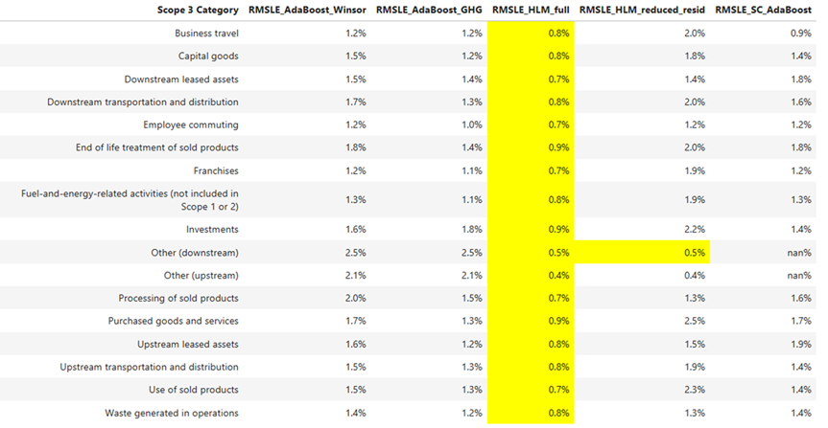
Comparing Model Errors Using RMSLE (Log Scale)
• Root-Mean-Squared-Log-Error (RMSLE)
What it measures: ▸ RMSLE assesses how far off predictions are based on multiplicative factors rather than raw tonnes. ▸ Predicted and reported values are first log-transformed, then the error is evaluated by order of magnitude (× factor), not simple difference. (Koshur, 2024)
Interpretation: ▸ Lower RMSLE values indicate better fit. ▸ A 0% RMSLE would mean a perfect match between model predictions and actual data on a log scale.
Notes:
Now that we've talked about R² and how much variation we explain, let's shift focus to how far off our models actually are — using a metric called RMSLE, or Root-Mean-Squared-Log-Error.
RMSLE measures misses in terms of factors, not tonnes. Instead of judging by raw differences, it first puts everything on a log scale and then evaluates how far apart the predicted and real values are by order of magnitude.
In simpler terms, smaller RMSLE numbers mean better accuracy, with 0% meaning a perfect match between the model’s curve and the real-world data.
Looking at the table on the right: Each row shows a Scope 3 category — like 'Business Travel' or 'Use of Sold Products' — and each column shows the RMSLE for a different model.
We want low numbers here.
The highlighted column shows results for our full hierarchical model. You can see it consistently delivers some of the lowest RMSLE scores, often below 1%.
For example:
In 'Other (upstream)' emissions, we achieved an RMSLE of just 0.4% — meaning the model was extremely close to matching actual reported emissions in log space.
Even in more challenging categories like 'Processing of Sold Products,' the full model still performed very strongly at 0.7% RMSLE.
The takeaway is that Our hierarchical model with full features not only explains a lot of the variance — it also minimizes the magnitude of errors across a wide range of Scope 3 sources."

Slide 27
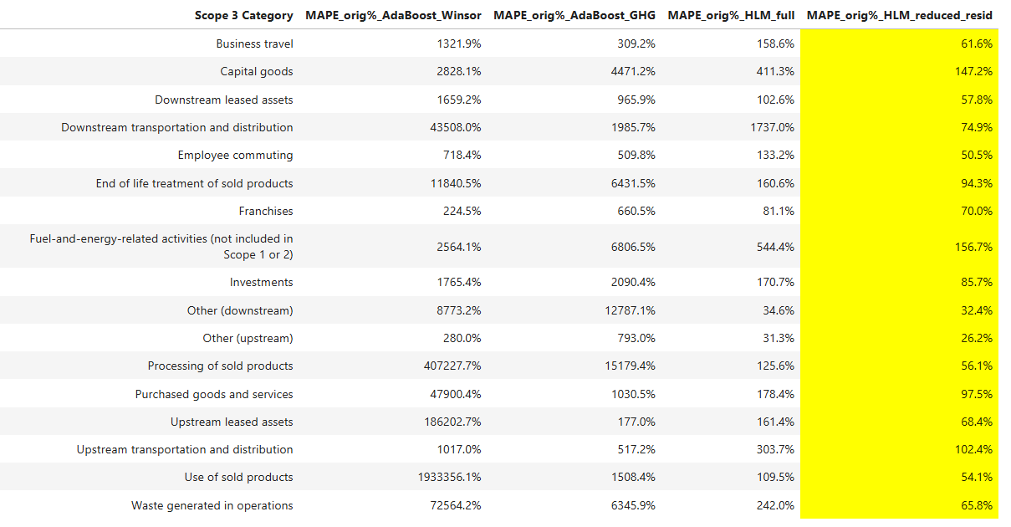
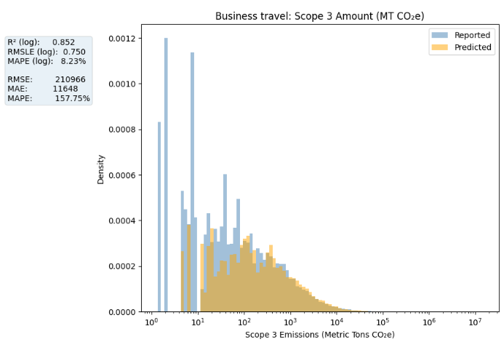
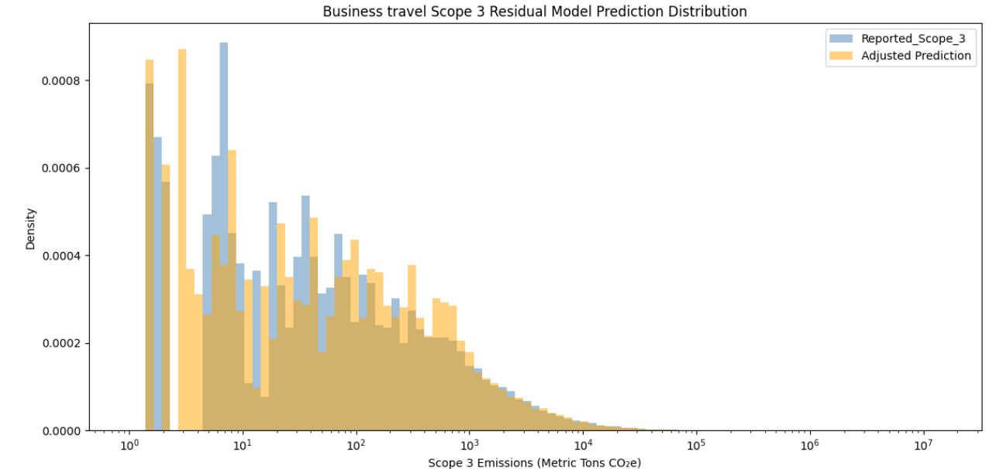
Comparing Model Misses Using MAPE (Real Scale)
Mean Absolute Percentage Error
What it measures: ▸ MAPE captures the average percentage miss, based on the true value of CO₂ emissions.
Simple interpretation: ▸ A 15% MAPE means the typical prediction is either 15% higher or 15% lower than the actual tons of CO₂e.
Why lower is better: ▸ Smaller MAPE = thin slice error → forecasts stay close to real emissions. ▸ Larger MAPE = larger slice error → forecasts are less trustworthy. (Bobbit, 2021)
Note: Extremely high MAPE values occur where Scope 3 amounts are near-zero, making % errors misleading.
Residual Modeling
Notes:
Now let's talk about MAPE, or Mean Absolute Percentage Error, and what it tells us about model performance.
First, MAPE measures the average percentage miss, based on the true value of CO₂ emissions. In other words, it answers: "On average, how far off are we, relative to the actual emissions?"
A simple way to think about it: If our model has a MAPE of 15%, that means that, on average, each prediction is about 15% higher or lower than the real Scope 3 emission.
So, when MAPE is small, the error is just a thin slice — meaning the model’s forecasts stay close to reality. But when MAPE is large, the slice becomes much bigger, and the forecasts become less reliable — meaning we can't trust them as much to reflect actual emissions behavior. (Bobbit, 2021)
One important thing to note: Some of the extremely high MAPE values you’ll see — numbers in the thousands of percent — happen when Scope 3 amounts are near-zero. In those cases, even a small tonnage miss looks like a huge percentage error, so the MAPE becomes misleading. It’s an artifact of working with small denominators, not necessarily a huge modeling failure.
Now, in terms of improvements: By applying residual modeling, we were able to lower the MAPE in many categories, especially where the original models were over- or under-predicting certain ranges.
You can see good progress — but there are still categories where MAPE remains relatively high, showing there’s room for further improvement. Particularly, categories with inherently low reported emissions or very wide ranges remain the most challenging to model precisely.

Slide 28
Findings, limitations, and future opportunities
Extreme Outliers Require Filtering: Unfiltered outliers—particularly in Scope 1, 2, and 3 emissions—can significantly distort model performance. Robust outlier handling is essential for generating reliable and generalizable results.
Adaboost Performance Limitation: While effective in log-transformed space, AdaBoost underperformed when predictions were converted back to actual metric tons, indicating limited utility in modeling real-scale emissions without further correction.
Consistently Influential Predictors: Financial indicators such as Revenue and Market Capitalization emerged as consistently significant across models, reaffirming their predictive value in emissions estimation.
Hierarchical Linear Modeling (HLM) + Residual Learning: HLM alone offered interpretable and context-aware forecasts but combining it with residual modeling led to measurable improvements in accuracy, especially for edge cases and underrepresented entities.
Future Opportunity – Missing Corporate Data: Find other sources for more complete corporate historical data (employee counts, climate change investments). Impute missing values where possible.
Future Opportunity – Leverage Scope 1 & 2 Data: Explore effective preprocessing techniques for Scope 1 and 2 emissions data and evaluate their predictive value. If found to be significant, integrate them as key features within the Hierarchical Linear Modeling (HLM) framework to enhance model robustness and interpretability.
Notes:
This final slide summarizes key insights from the modeling effort and highlights areas for continued improvement.
First, we found that extreme outliers—must be filtered to ensure model stability and generalizability.
While AdaBoost performed well in log space, its effectiveness dropped when converting predictions back to real-world units, signaling the need for post-processing or complementary approaches.
On the positive side, financial indicators like revenue and market cap consistently proved to be strong predictors across all models.
Hierarchical Linear Modeling offered a structured, interpretable solution, and its pairing with residual learning significantly improved performance—particularly for difficult-to-predict cases.
Looking ahead, addressing gaps in corporate data and better leveraging Scope 1 and 2 emissions present valuable opportunities.
These enhancements could further refine our models and build a stronger foundation for Scope 3 estimation at scale.

Slide 29
References:
References:
Bobbitt, Z. (2021, May 10). How to interpret MAPE values. Statology. https://www.statology.org/how-to-interpret-mape/
GHG Protocol. (n.d.). Scope 3 calculation guidance: Making corporate value chain accounting easier than ever. World Resources Institute. Retrieved April 29, 2025, from https://ghgprotocol.org/scope-3-calculation-guidance-2
Hearts of Science, LLC, & Python for Data Science, LLC. (2025). Mixed-effects regression in Python. In Python for Data Science. https://www.pythonfordatascience.org/mixed-effects-regression-python/
Koshur, AI. (2024, February 20). Demystifying RMSLE: A comprehensive guide to root mean squared logarithmic error. Medium. https://koshurai.medium.com/demystifying-rmsle-a-comprehensive-guide-to-root-mean-squared-logarithmic-error-661820cb292d
Rocca, R. (2024, February 19). Interpreting R²: A narrative guide for the perplexed. Towards Data Science. https://towardsdatascience.com/interpreting-r%C2%B2-a-narrative-guide-for-the-perplexed-086a9a69c1ec/
Sahu, M. (2023, May 25). Managing Scope 3 GHG emissions in the steel industry [Image]. Cyient. https://www.cyient.com/blog/managing-scope-3-ghg-emissions-in-the-steel-industry
Serafeim, G., & Vélez Caicedo, G. (2022). Machine learning models for prediction of Scope 3 carbon emissions (Working Paper No. 22-080). Harvard Business School.

